Slide 1
Importance of Ordinances and Covenants
President Brian Holman Adult Session, April 2024 Stake Conference, Provo West Stake

Slide 3
Dear brothers and sisters, I grieve for those who leave the Church because they feel membership requires too much of them. They have not yet discovered that making and keeping covenants actually makes life easier! Each person who makes covenants in baptismal fonts and in temples—and keeps them—has increased access to the power of Jesus Christ.
Please ponder that stunning truth!

Slide 4
The reward for keeping covenants with God is heavenly power—power that strengthens us to withstand our trials, temptations, and heartaches better. This power eases our way. Those who live the higher laws of Jesus Christ have access to His higher power. Thus, covenant keepers are entitled to a special kind of rest that comes to them through their covenantal relationship with God.

Slide 5
General Handbook 27.2: Endowment
The word endowment means “a gift.” The temple endowment is literally a gift from God through which He blesses His children. The endowment can be received only in holy temples. Some of the gifts that members receive through the temple endowment include:
Greater knowledge of the Lord’s purposes and teachings.
Power to do all that Heavenly Father wants His children to do.
Divine direction when serving the Lord, their families, and others.
Increased hope, comfort, and peace.
All the promised blessings of the endowment are in force both in this life and for eternity. The fulfillment of these blessings depends on faithfulness to the gospel of Jesus Christ.

Slide 6
General Handbook 27.2: Endowment
In the endowment, members are invited to make sacred covenants as follows:
Live the law of obedience and strive to keep Heavenly Father’s commandments.
Obey the law of sacrifice, which means sacrificing to support the Lord’s work and repenting with a broken heart and contrite spirit.
Obey the law of the gospel of Jesus Christ, which means:
Exercising faith in Jesus Christ.
Repenting daily.
Making covenants with God by receiving the ordinances of salvation and exaltation.
Enduring to the end by keeping covenants.
Striving to live the two great commandments. These are to “love the Lord thy God with all thy heart, and with all thy soul, and with all thy mind” and to “love thy neighbor as thyself” (Matthew 22:37, 39).
Keep the law of chastity, which means abstaining from sexual relations outside of a legal marriage between a man and a woman, which is according to God’s law.
Keep the law of consecration, which means that members dedicate their time, talents, and everything with which the Lord has blessed them to building up Jesus Christ’s Church on the earth.

Slide 7
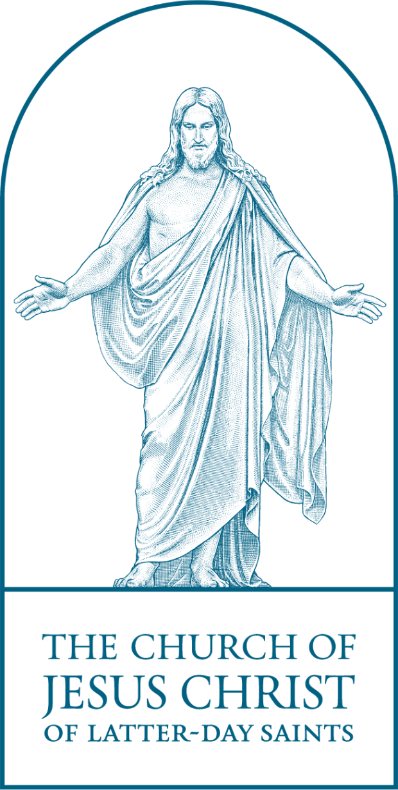
Temple Covenants lead us to Christ
Law of the Gospel of Jesus Christ
Law of Obedience
Law of Sacrifice
Law of Consecration
Becoming more like the Savior
Law of Chastity

Slide 8
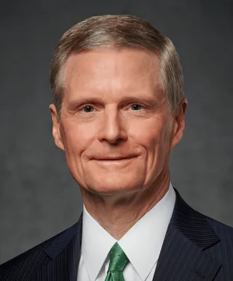
Elder David A. Bednar Quorum of the Twelve Apostles
“Every time we faithfully receive, review, remember and renew sacred covenants, our spiritual anchors are secured ever more firmly and steadfastly to the ‘rock’ of Jesus Christ. As individuals build their foundations upon the Savior, they are blessed to “be still.” The Lord provides both sacred times and holy places to help individuals experience and learn about this inner stillness of their souls. Our homes should be the ultimate combination of both sacred time and holy places wherein individuals and families can ‘be still’and know that God is our Heavenly Father, we are His children and Jesus Christ is the Savior.”
April 2023 General Conference

Slide 9
Do you honor your sacred privilege to wear the garment as instructed in the initiatory ordinances?
The garment of the holy priesthood reminds us of the veil in the temple,
and that veil is symbolic of Jesus Christ. When you put on your garment, you
put on a sacred symbol of Jesus Christ. Wearing it is an outward expression of
your inner commitment to follow Him. The garment is also a reminder of your
temple covenants. You should wear the garment day and night throughout
your life. When it must be removed for activities that cannot reasonably be
done while wearing the garment, seek to restore it as soon as possible. As you
keep your covenants, including the sacred privilege to wear the garment as
instructed in the initiatory ordinances, you will have greater access to the
Savior’s mercy, protection, strength, and power.

Slide 10
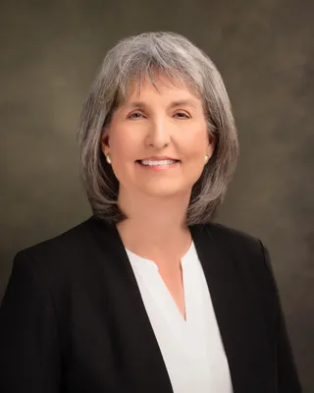
Sister J. Anette Dennis General Relief Society Presidency
“Our temple garment reminds us that the Savior and the blessings of His Atonement cover us throughout our lives. As we put on the garment of the holy priesthood each day, that beautiful symbol becomes a part of us.
By keeping my covenants and obligations with God, including wearing the garment of the holy priesthood, my very life can become a personal symbol of my love and deep gratitude for my Savior, Jesus Christ, and my desire to have Him with me always.”
April 2023 General Conference

Slide 11
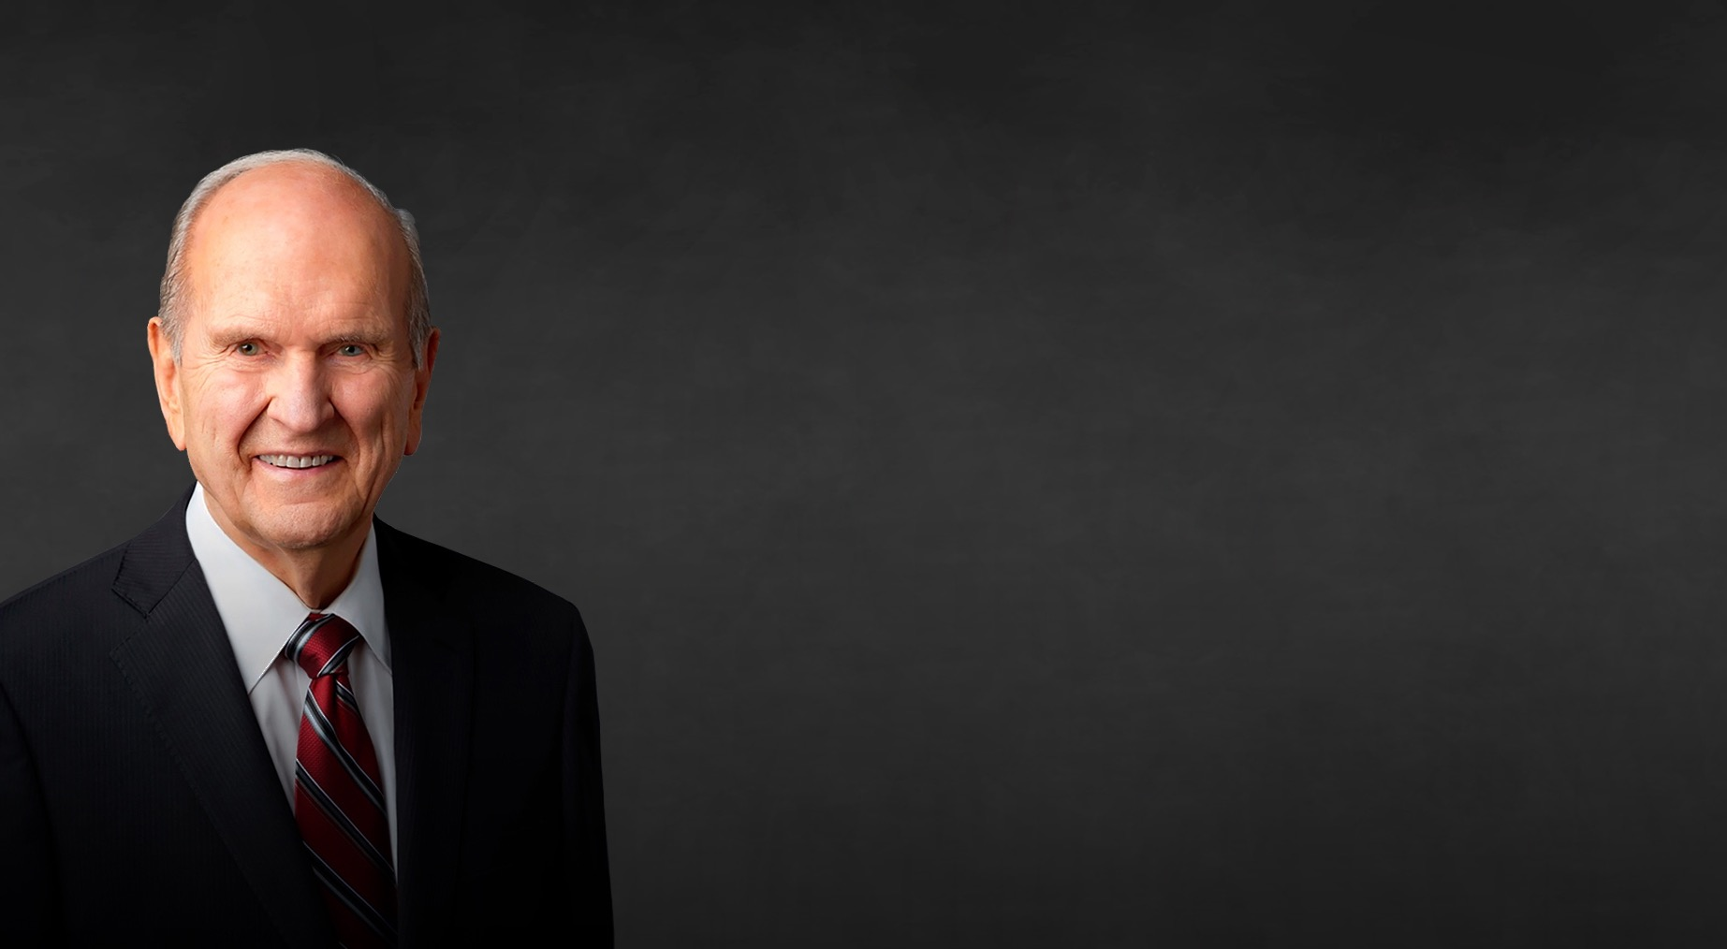
Wherever your personal “closet” may be—whether it be a literal closet, or some other place where you can enjoy seclusion, plan to have a period of private time in that setting to prepare, to ponder, and to pray.
Prior to doing so, you will have clothed yourself with the garment of the holy priesthood. This may seem little more than a routine step in preparing for the day. However, as you clothe yourself in this holy garment, please think about the temple. Specifically, I invite you to reflect upon those moments when you stand at the veil of the temple.

