Slide 1
Unity in Purpose and Effort: Our Opportunity and Obligation
President Brian Holman Leadership Session, April 2022 Stake Conference, Provo West Stake

Slide 2
“Be ye not unequally yoked together”—2 Corinthians 6:14

Slide 3
In what ways can we be unequally yoked as ward councils, stake councils, or presidencies?

Slide 4
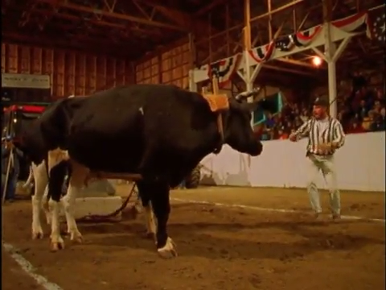
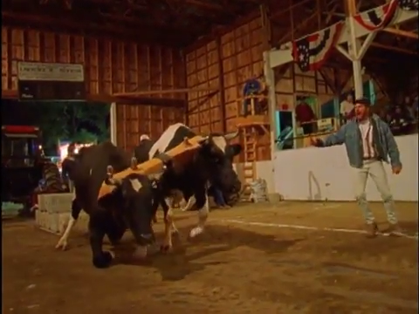
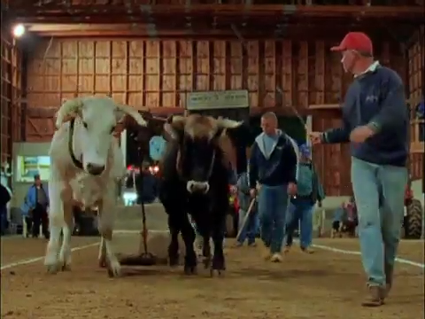
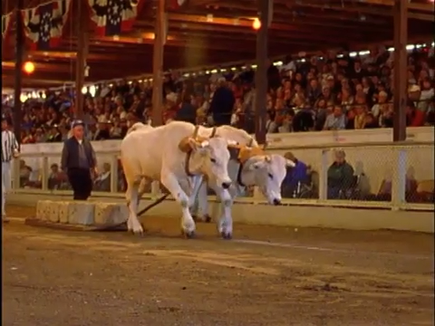
“Be ye not unequally yoked together”—2 Corinthians 6:14
Wrong Direction
Moving Ahead and Falling
Council focuses on things other than core mission to bring others to Christ. Illusion of Progress.
Leaders try to do it all themselves and get burned out. Progress is stopped.
Moving Ahead, Slow Progress
Heads down and united
Leader tries to do it all themselves without fully engaging other council members. Limits potential.
Council is working together focused on their core mission to bring others to Christ. Progress accelerates.

Slide 5
What are the causes of being unequally yoked as councils?

Slide 6
Lack of Engagement
Unprepared for meetings (leader needs to give the space and time for council members to prepare and then follow-up)
Forget about assignments and commitments
Deferring to the Leader for All Solutions
Contention or Disrespect of other Council Members
Dominating the Discussion
Public Agreement and Private Discord
Not focusing on individual and family needs
Not focusing on moving the Work of Salvation forward
Not focusing on solutions and actions
Not meeting regularly

Slide 7
What are the potential unintended consequences if this isn’t corrected?
How does this affect our ability to move the work forward?

Slide 8
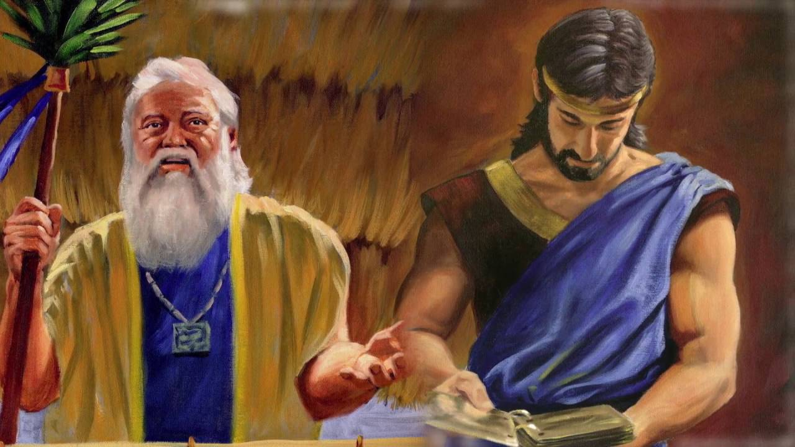
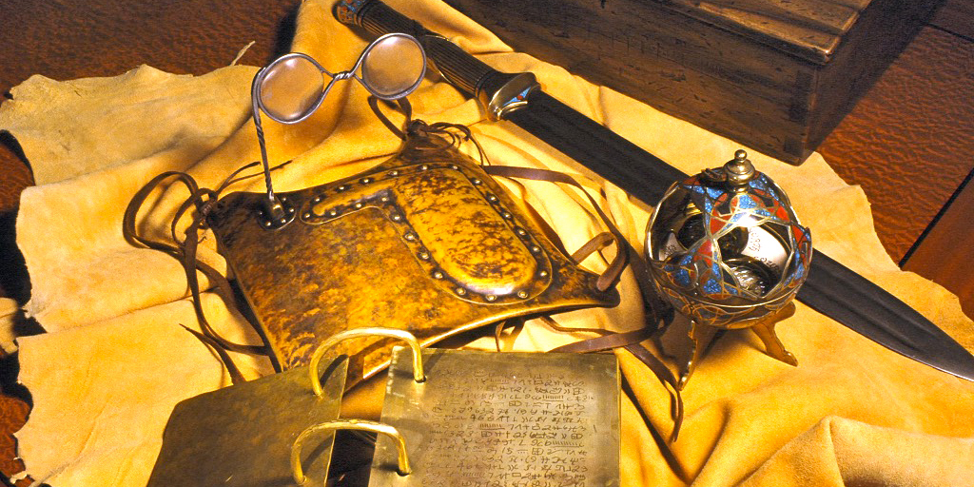
Mosiah 1:15-17
And it came to pass that after king Benjamin had made an end of these sayings to his son, that he gave him charge concerning all the affairs of the kingdom.
And moreover, he also gave him charge concerning the records which were engraven on the plates of brass; and also the plates of Nephi; and also, the sword of Laban, and the ball or director, which led our fathers through the wilderness, which was prepared by the hand of the Lord that thereby they might be led, every one according to the heed and diligence which they gave unto him.
Therefore, as they were unfaithful they did not prosper nor progress in their journey, but were driven back, and incurred the displeasure of God upon them; and therefore they were smitten with famine and sore afflictions, to stir them up in remembrance of their duty.
Benjamin reminds Mosiah about the lesson of the Liahona
Notes:
Benjamin reminded Mosiah about the lesson of the Liahona

Slide 9
Councils help us seek the Lord’s will in unity and faith. Councils function in all levels of the Church, including general, area, stake, ward, quorum, and other leadership councils.
The purpose of Church councils is to seek and obtain divine revelation. Church councils are an environment where we can receive inspiration to make decisions, better serve individuals and families, and plan and coordinate the work of the Church.
Gospel Topics: Church Councils
Purpose of Councils
Notes:
https://www.churchofjesuschrist.org/manual/gospel-topics/church-councils?lang=eng

Slide 10
Councils operate differently in the Church than they do in other decision-making bodies. They are not governed by majority rule or best practice, and the leader does not make decisions on his or her own. When a question or need is brought to the council for consideration, council members are encouraged to speak honestly, both from their personal experience and from their positions as organization leaders.

Slide 11
Councils bring together the insight of people with diverse backgrounds, experience, and viewpoints. These differences strengthen the council, and everyone should feel safe to express his or her opinion in a spirit of love and kindness. Such expression is essential to the purpose of councils, so leaders should establish a climate in which every person is heard and every opinion valued. As council members listen, humbly consider others’ feelings, and seek to know Heavenly Father’s will, a spirit of inspiration and unity can prevail.

Slide 12
Church councils are most successful when all involved set aside personal preferences and seek to know the will of the Lord—when they follow Alma’s admonition: “Counsel with the Lord in all thy doings, and he will direct thee for good” (Alma 37:37). The leader of the council does not decide how to resolve a question until he or she has heard the discussion. The leader encourages discussion without dominating it and asks questions and may ask particular council members for their suggestions. The leader listens carefully before making a decision. These discussions should foster a spirit of inspiration. After counseling with the group, the leader, following the inspiration of the Spirit, may make a decision or propose a course of action for the council to consider.

Slide 13
Working Together in the Ward Council

Slide 14
Each leader knew the family, each felt a responsibility to help them, and each participated in the council discussion.
They understood that most of the work to help the family would take place outside of the meeting.
They also understood that they were expected to involve other quorum and auxiliary members in reaching out to serve the family.
As they counselled together, they felt a spirit of unity.
Through the influence of the Holy Ghost, they understood the needs of the family more clearly.
After listening carefully to the inspired discussion, the bishop exercised priesthood keys and assigned leaders in the Sunday School, high priest group, and Relief Society to visit the family that week.

Slide 15
Because leaders worked together, much was accomplished.
The Sunday School president helped the family begin studying the scriptures together.
The high priest group leader taught the brother how to administer to his family.
The Relief Society presidency learned of the family's urgent welfare needs and worked with the priesthood executive committee to address them.
The ward council works together with each leader doing their part.
After many months, hearts were softened and progress was made.

Slide 16
When leaders labor together in the Lord's vineyard, much is accomplished.
As they counsel about specific needs, make plans to meet those needs, and then carry out their plans working together in a spirit of love and unity, families and individuals are blessed.
Because, when the Lord's servants work together, the Lord Himself also works with them.

Slide 17
The leader listened carefully as council members from many organizations offered inspired ideas of how to help.
The leaders sought the guidance of the Holy Ghost as they counselled together.
When the bishop had heard everyone's inspired ideas, he exercised priesthood keys to assign specific leaders to take action.
Those leaders worked together to fulfill their assignments and minister to the family over an extended period of time.
At each council meeting, they reported back on their efforts.
As you consider your role as a member of the ward council, you may want to ask yourself, “How can I improve my spiritual preparation for our council meetings? How can we better work together across organizations to bless the members of our ward?”

Slide 18
